Slide 1
Prevention Theory in Firearms
David Hemenway, PhD
Harvard Injury Control Research Center
NIJ Firearms Research Working Group
December 1, 2011
Notes:
Prevention Theory in Firearms
David Hemenway, PhD
Harvard Injury Control Research Center
NIJ Firearms Research Working Group
December 1, 2011

Slide 2
1. Public Health
2. Suicide
3. Self-Defense Gun Use
Notes:
1. Public Health
2. Suicide
3. Self-Defense Gun Use

Slide 3
What Public Health Adds to the
Criminal Justice/Criminology Approach
Notes:
What Public Health Adds to the
Criminal Justice/Criminology Approach

Slide 4
National Research Council (NRC)
No one on the committee was an injury-control professional.
Few worked directly in public health (e.g., no one worked at a public health school).
Notes:
National Research Council (NRC)
No one on the committee was an injury-control professional.
Few worked directly in public health (e.g., no one worked at a public health school).

Slide 5
Gratuitous, superfluous comments @ injury-prevention field:
“Some of the problems in the suicide literature may also be attributable to the intellectual traditions of the injury prevention field. An unintentional injury prevention model can lead to misunderstandings when it is applied to the study of intentional injury; the investigation of intentional injury needs to take account of the complexities of preference, motivation, constraint, and social interaction among the individuals involved.” (194)
Notes:
Gratuitous, superfluous comments @ injury-prevention field:
“Some of the problems in the suicide literature may also be attributable to the intellectual traditions of the injury prevention field. An unintentional injury prevention model can lead to misunderstandings when it is applied to the study of intentional injury; the investigation of intentional injury needs to take account of the complexities of preference, motivation, constraint, and social interaction among the individuals involved.” (194)
Is page number from NRC report? Need reference: National Research Council, Firearms and Violence: A Critical Review, Committee to Improve Research Information and Data on Firearms, Charles F. Wellford, John V. Pepper, and Carol V. Petrie, editors, Committee on Law and Justice, Division of Behavioral and Social Sciences and Education. Washington, D.C.: The National Academies Press, 2005.

Slide 6
Public Health Approach
Broad approach
Assets as well as liabilities
Upstream prevention
vs. proximate cause, don’t focus just on criminal
Notes:
Public Health Approach
Broad approach
Assets as well as liabilities
Upstream prevention vs. proximate cause, don’t focus just on criminal

Slide 7
Public Health Approach
Prevention (proactive vs. reactive)
Community (vs. one at a time)
No-fault/blame
Systems approach
Notes:
Public Health Approach
Prevention (proactive vs. reactive)
Community (vs. one at a time)
No-fault/blame
Systems approach

Slide 8
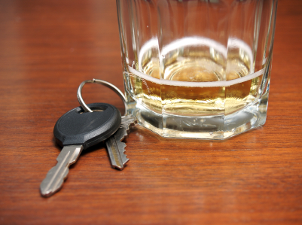
Motor Vehicles
Most motor vehicle deaths are associated with clear and deliberate unlawful behavior by motorists
(e.g., speeding,
drunk driving,
running red lights)
Notes:
Motor Vehicles
Most motor vehicle deaths are associated with clear and deliberate unlawful behavior by motorists
(e.g., speeding, drunk driving, running red lights)

Slide 9
Emphasis also on
agent of injury – car
physical environment – roads
social environment – e.g., designated driver
Notes:
Emphasis also on
agent of injury – car
physical environment – roads
social environment – e.g., designated driver

Slide 10
Are drivers today better and more law-abiding?
Fatalities per vehicle mile fall 90%
Notes:
Are drivers today better and more law-abiding?
Fatalities per vehicle mile fall 90%

Slide 11
Medical Lens
Criminology Public Health
Sociology Epidemiology
(factor analysis) (case control)
Notes:
Medical Lens
Criminology Public Health
Sociology Epidemiology
(factor analysis) (case control)

Slide 12
Medical Lens
Criminology Public Health
Data
Arrests ED visits
a) Child abuse
b) Intimate partner violence
c) Bullying (verbal abuse, intimidation)
Notes:
Medical Lens
Criminology Public Health
Data
Arrests ED visits
[arrow]
a) Child abuse
b) Intimate partner violence
c) Bullying (verbal abuse, intimidation)

Slide 13
Public Health Approach
Upstream Prevention
Medical Lens
Advocacy + Action
Bring together a wide array of organizations / interests under the banner of public health
Change social norms (as well as formal policies)
Notes:
Public Health Approach
Upstream Prevention
Medical Lens
Advocacy + Action
Bring together a wide array of organizations/interests under the banner of public health
Change social norms (as well as formal policies)

Slide 14
What has the Harvard School of Public Health been doing in violence prevention?
Notes:
What has the Harvard School of Public Health been doing in violence prevention?

Slide 15
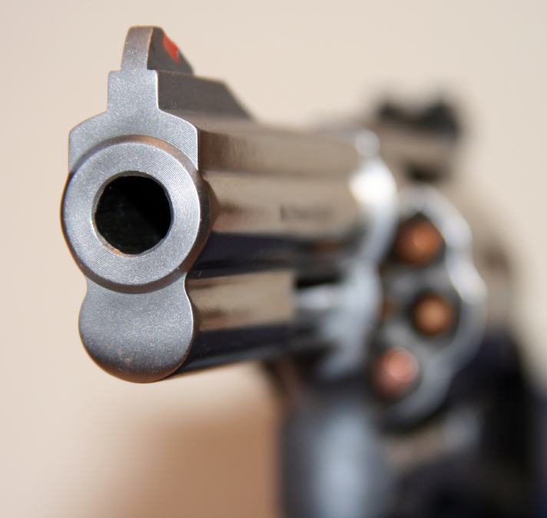
Surveillance Systems
National Violent Death Reporting System
Notes:
Surveillance Systems
National Violent Death Reporting System

Slide 16
HOMICIDE | suicide
Notes:
HOMICIDE | suicide

Slide 17
HOMICIDE | suicide
NVISS 2001-2002

Slide 18
The NVDRS Advantage Unintentional Firearm Death
Victims
Age | N | % Other Inflicted
0-14 | 72 | 78%
15-24 | 121 | 60%
25-54 | 127 | 33%
55+ | 43 | 19%
Gender
Male | 330 | 47%
Female | 33 | 73%
Hemenway et al 2010

Slide 19
Shooters in Other-Inflicted
Age | % of Total
0-14 | 35%
15-24 | 46%
25-54 | 14%
55+ | 4%
Gender
Male | 92%
Female | 8%
Hemenway et al 2010

Slide 20
Boston Data Project
High school surveys
Adult surveys
Assemble existing data
Notes:
Boston Data Project
High school surveys
Adult surveys
Assemble existing data

Slide 21
Boston Youth Survey:
Violence
Fear
Witnessing
Victimization
Perpetration
Peer
Sibling
Dating
Notes:
Boston Youth Survey: Violence
Fear
Witnessing
Victimization
Perpetration
Peer
Sibling
Dating

Slide 22

Sleep and Aggression
Study 1
BYS 2006
Hours of Sleep
 | 8+ (14%) | 6-7 (58%) | ≤5 (30%)
Aggressive behavior in past month
30%
38%
40%
Amount of sleep associated with what time school starts.
Notes:
Sleep and Aggression
Amount of sleep associated with what time school starts.

Slide 23
Peer Perceptions of Gun Carrying
Study 4
BYS 2008
Gun Carrying Overestimates
Self-reported Carrying | 5.5%
Mean estimate of classmates carrying | 15.9%
Mean estimate of neighborhood carrying | 32.6%

Slide 24
Gun Carrying Overestimates
BYS 2008
 | Overestimates of Peer Carrying (>15%) | Overestimates of Peer Carrying (<15%)
Self-reported Carrying | 7.8% | 2.2%

Slide 25
Difficulty for Teenagers to Get a Gun
BYS 2008
 | EASY | DIFFICULT | IMPOSSIBLE
Estimated Difficulty for OTHER KIDS to get gun | 68% | 24% | 8%
Estimated difficulty of SELF to get gun | 39% | 24% | 36%
Ideal world- How easy for teens to get a gun | 18% | 14% | 68%

Slide 26
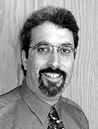
Collaborations
1. Helping pediatricians help parents prevent violence (e.g., corporal punishment, bullying)
www.aap.org/connectedkids/ClinicalGuide.pdf
Notes:
Collaborations
1. Helping pediatricians help parents prevent violence (e.g., corporal punishment, bullying)

Slide 27
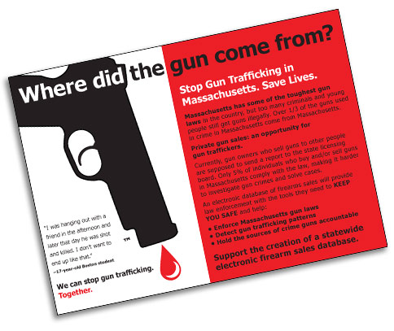
Collaborations (cont.)
Working with nonprofits to change media role (Hollywood, reporters)
(e.g., “Where did the gun come from?”)
http://www.wheredidtheguncomefrom.com/
Notes:
Collaborations (cont.)
Working with nonprofits to change media role (Hollywood, reporters)
(e.g., “Where did the gun come from?”)

Slide 28


Collaborations (cont.)
Helping students “speak up”
http://www.paxusa.org
Notes:
Collaborations (cont.)
3. Helping students “speak up”

Slide 29

Collaborations (cont.)
Working with survivors
(e.g., toolkit for first responders)
Notes:
Collaborations (cont.)
Working with survivors
(e.g., toolkit for first responders)

Slide 30

Collaborations (cont.)
5. Working with gun stores to reduce gun suicide
Notes:
Collaborations (cont.)
5. Working with gun stores to reduce gun suicide

Slide 31






Collaborations (cont.)
6. Working with a dozen grassroots community organizations → helping them work together
Notes:
Collaborations (cont.)
6. Working with a dozen grassroots community organizations → helping them work together

Slide 32
What does public health add?
Conclusion
Government institutions: CDC, NIH, state and local health departments
New research professionals:
  Doctors and public health professionals
  New data sources
  New analytic tools
Energize and coordinate nonprofits
Notes:
Conclusion
What does public health add?
Government institutions: CDC, NIH, state and local health departments
New research professionals:
– Doctors and public health professionals
– New data sources
– New analytic tools
Energize and coordinate nonprofits

Slide 33
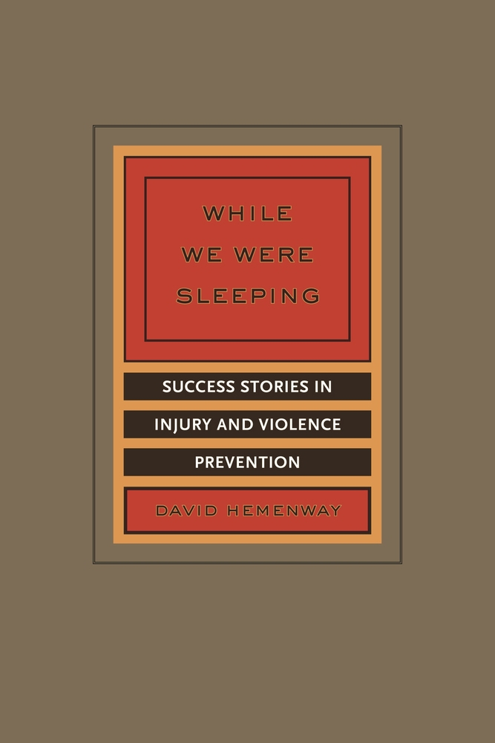
Many Public Health Successes

Slide 34
Having a household gun:
Good for society?
Good for the individual household?
Costs: Benefits:
Accidents Deterrence
Suicide Thwart crime
Assault Self-defense gun use
Intimidation
and who actually gets shot
Notes:
Having a household gun:
Good for society?
Good for the individual household?
Costs: Benefits:
Accidents Deterrence
Suicide Thwart crime
Assault Self-defense gun use
Intimidation
and who actually gets shot

Slide 35
Suicide
Notes:
Suicide

Slide 36
Limitation of NRC: reach the same conclusion in all areas:
Really don’t know anything
When actually know a lot more in some areas more than others…
Notes:
Limitation of NRC: reach the same conclusion in all areas:
Really don’t know anything
When actually know a lot more in some areas more than others…

Slide 37
Suicide
“All of the (case control) studies that the committee reviewed have found a positive association between household gun ownership and suicide risk.” (173)
“There appears to be a cross-sectional association between rates of household gun ownership and overall rates of suicide, reported on both sides of the gun policy debate.” (193)
Main conclusion: “the committee cannot determine whether these associations demonstrate causal relationships.” (6)
“The issue of substitution has been almost entirely ignored in the literature of guns and suicide.” (194)
Notes:
Suicide
“All of the (case control) studies that the committee reviewed have found a positive association between household gun ownership and suicide risk.” (173)
Need reference for page numbers. National Research Council, Firearms and Violence: A Critical Review, Committee to Improve Research Information and Data on Firearms, Charles F. Wellford, John V. Pepper, and Carol V. Petrie, editors, Committee on Law and Justice, Division of Behavioral and Social Sciences and Education. Washington, D.C.: The National Academies Press, 2005.
“There appears to be a cross-sectional association between rates of household gun ownership and overall rates of suicide, reported on both sides of the gun policy debate.” (193)
Main conclusion: “the committee cannot determine whether these associations demonstrate causal relationships.” (6)
“The issue of substitution has been almost entirely ignored in the literature of guns and suicide.” (194)

Slide 38
Lots of studies since NRC report actually completed:
Notes:
Lots of studies since NRC report actually completed:

Slide 39
A) Gun owners are NOT more depressed or suicidal
Multivariate odds ratios:
Living in household with firearm versus not living in household with firearm from National
Co-morbidity Survey
Anxiety disorder 1.0
Mood disorder 0.9
Substance Use 0.9
Suicide Ideation 0.8
Suicidal Plan 0.5
Miller et al. (2009) “Recent psychopathology, suicidal thoughts and suicide attempts in households with and without firearms.” Injury Prevention.
Notes:
A) Gun owners are NOT more depressed or suicidal
Multivariate odds ratios:
Living in household with firearm versus not living in household with firearm from National
Co-morbidity Survey
Anxiety disorder 1.0
Mood disorder 0.9
Substance Use 0.9
Suicide Ideation 0.8
Suicidal Plan 0.5
Miller, M., C. Barber, D. Azrael, D. Hemenway and B. E. Molnar. (2009). “Recent psychopathology, suicidal thoughts and suicide attempts in households with and without firearms: Findings from the National Comorbidity Study Replication.” Injury Prevention 15: 183-187.

Slide 40
Mental Health of Gun Owners
(additional confirming studies)
Oslin et al. (2004). “Managing suicide risk in late life: Access to firearms as a public health risk.” American Journal of Geriatric Psychiatry.
Ilgen et al. (2008). “Mental illness, previous suicidality and access to guns in the United States. Psychiatric Services.
Sorenson and Vittes. (2008). “Mental health and firearms in community-based surveys: Implications for suicide prevention.” Evaluation Review.
Kolla, O’Connor and Lineberry. (2011). “The base rates and factors associated with reported access to firearms in psychiatric inpatients. General Hospital Psychiatry.
Notes:
Mental Health of Gun Owners (additional confirming studies)
Oslin, D.W., C. Zubritsky, G. Brown, M. Mullahy, A. Puliafico, and T. Ten Hare. (2004).“Managing suicide risk in late life: Access to firearms as a public health risk.” American Journal of Geriatric Psychiatry 12 (1): 31-36.
Ilgen, M.A., K. Zirin, R.J. McCammon, and M. Valenstein. (2008). “Mental illness, previous suicidality and access to guns in the United States. Psychiatric Services 59 (2): 198-200.
Sorenson, S.B., and K. Vittes. (2008). “Mental health and firearms in community-based surveys: Implications for suicide prevention.” Evaluation Review 32: 239-256.
Kolla, B.P., S.S. O’Connor and T.W. Lineberry. (2011). “The base rates and factors associated with reported access to firearms in psychiatric inpatients. General Hospital Psychiatry 33 (2): 191-196.

Slide 41
B) Cross-Sectional Ecological Studies of Gun Ownership and Suicide
“Potentially valuable state-level information could be made available through the regular inclusion of gun-ownership questions in the Behavioral Risk Factor Surveillance System.” (NRC, 195)
Notes:
B) Cross-Sectional Ecological Studies of Gun Ownership and Suicide
“Potentially valuable state-level information could be made available through the regular inclusion of gun-ownership questions in the Behavioral Risk Factor Surveillance System.” (NRC, 195)
National Research Council, Firearms and Violence: A Critical Review, Committee to Improve Research Information and Data on Firearms, Charles F. Wellford, John V. Pepper, and Carol V. Petrie, editors, Committee on Law and Justice, Division of Behavioral and Social Sciences and Education. Washington, D.C.: The National Academies Press, 2005.

Slide 42
Cross-Sectional Ecological Studies of Gun Ownership and Suicide
“Potentially valuable state-level information could be made available through the regular inclusion of gun-ownership questions in the Behavioral Risk Factor Surveillance System.” (NRC, 195)
Such questions were included in 2001, 2002, 2004 Behavioral Risk Factor Surveillance System (BRFSS), the world’s largest telephone survey (>200,000 respondents)
Notes:
Cross-Sectional Ecological Studies of Gun Ownership and Suicide
“Potentially valuable state-level information could be made available through the regular inclusion of gun-ownership questions in the Behavioral Risk Factor Surveillance System.” (NRC, 195)
Such questions were included in 2001, 2002, 2004 Behavioral Risk Factor Surveillance System (BRFSS), the world’s largest telephone survey (>200,000 respondents)
National Research Council, Firearms and Violence: A Critical Review, Committee to Improve Research Information and Data on Firearms, Charles F. Wellford, John V. Pepper, and Carol V. Petrie, editors, Committee on Law and Justice, Division of Behavioral and Social Sciences and Education. Washington, D.C.: The National Academies Press, 2005.

Slide 43
Cross-Sectional State Studies
(results identical if using BRFSS or percentage of firearms suicides [FS/S])
Controlling for:
Poverty
Urbanization
Unemployment
Alcohol/substance abuse
Serious mental illness
Results: more guns more gun suicide
same non-gun suicide
more overall suicide
Miller et al. (2007) “Household firearm ownership and rates of suicide across the 50 U.S. states.” Journal of Trauma.
Notes:
Cross-Sectional State Studies
(results identical if using BRFSS or percentage of firearms suicides [FS/S])
Controlling for:
Poverty
Urbanization
Unemployment
Alcohol/substance abuse
Serious mental illness
Results: more guns more gun suicide
same non-gun suicide
more overall suicide
Miller, M., S. Lippmann, D. Azrael, and D. Hemenway. (2007). “Household firearm ownership and rates of suicide across U.S. states.” Journal of Trauma 62: 1029-1035.

Slide 44
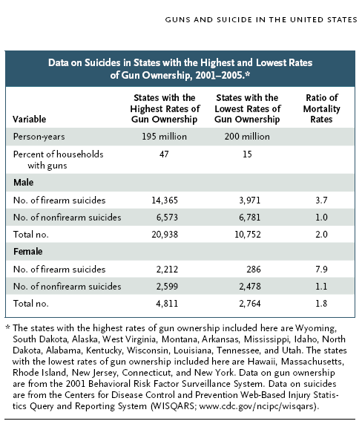
Miller M and Hemenway D. NEJM. September 4, 2008.
Notes:
44
Consistent with case control studies and cohort study of HMO (Cummings) and 200k purchasers in California over 6-year period (Wintemute), purchase of a handgun risk greatest in first year but persists for study period (6 yrs), risk to all household members (most to owner). Assail case control and ecologic gun owners more suicidal…no evidence but we tested this alternative hypothesis.

Slide 45
Suicide Rate 1994 – 1998 per 100,000
State | Households with Firearms (%) | Overall | Firearm | Non-Firearm
ME | 45% | 13.5 | 7.9 | 5.6
VT | 48% | 12.3 | 7.9 | 4.4
NH | 33% | 12.1 | 6.8 | 5.3
CT | 21% | 8.9 | 3.7 | 5.2
RI | 16% | 8.3 | 3.0 | 5.3
MA | 14% | 8.2 | 2.4 | 5.8
NJ | 12% | 7.3 | 2.4 | 4.9
Source: Miller et al., 2004. Firearms and suicide in the Northeast. J Trauma.
Notes:
Source: Miller. M., D. Hemenway, and D. Azrael. 2004. “Firearms and suicide in the Northeast.” Journal of Trauma 57: 626-632.

Slide 46
Cross-Sectional Ecological Studies
Gun Ownership and Suicide
(additional confirming results)
Kim et al. (2011). “Altitude, gun ownership, rural areas and suicide.” Am Journal of Psychiatry. (county-level analysis).
Kubrin and Wadsworth. (2009). “Explaining suicide among blacks and whites: how socioeconomic factors and gun availability affect race-specific suicide rates.” Social Science Quarterly. (city-level analysis).
Notes:
Cross-Sectional Ecological Studies
Gun Ownership and Suicide
(additional confirming results)
Kim, N., J. Mickelson, B. Brenner, C. Haws, D. Yurgelin-Todd, and P. Renshaw. (2011). “Altitude, gun ownership, rural areas, and suicide.” American Journal of Psychiatry 168: 49-54. (county-level analysis).
Kubrin, C., and T. Wadsworth. (2009). “Explaining suicide among blacks and whites: How socioeconomic factors and gun availability affect race-specific suicide rates.” Social Science Quarterly 90 (5): 1203-1227. (city-level analysis).

Slide 47
C) Ecological Time-Series Analysis (regional analysis)
(1981-2002)
  Control for age
  poverty
  alcohol
  unemployment
  region
  Changes in household gun ownership associated with significant changes in rates of gun suicide and overall suicide; not nongun suicide (for men, women, children).
  Miller et al. (2006). “The association between changes in household firearm ownership and rates of suicide in the United States, 1981-2002.” Injury Prevention.
Notes:
C) Ecological Time-Series Analysis (regional analysis)
(1981-2002)
Control for age
poverty
alcohol
unemployment
region
Changes in household gun ownership associated with significant changes in rates of gun suicide and overall suicide; not nongun suicide (for men, women, children).
Miller, M. D. Azrael, L. Hepburn, D. Hemenway and S. Lippmann. (2006). “The association between changes in household firearm ownership and rates of suicide in the United States, 1981-2002.” Injury Prevention 12 (3): 178-182.

Slide 48
Miller M, Azrael D, Hepburn L, Hemenway D, Lippmann SJ. The association between changes in household firearm ownership and rates of suicide in the United States, 1981-2002. Inj Prev. 2006; 12(30):178-82
Notes:
Only one prior study null finding Clarke and Mayhew? Years no change in hhg two surveys measurement error larger than recorded changes in HHG
Now have larger change so can do and recently, 2001, state level…
Note: Found two publications for Clarke and Mayhew, listed below:
Clarke, Ronald V. and Pat Mayhew. 1980. Designing out Crime. London: Her Majesty’s Stationery Office.
Clarke, Ronald V. and Pat Mayhew. 1988. “The British Gas Suicide Story and its Implications for Prevention”. In Michael Tonry and Norval Morris (eds.), 1988. Crime and Justice: A Review of Research, Vol.10. Chicago: University of Chicago Press.

Slide 49
D) Gun control laws may reduce suicide
Webster et al. (2004). “Association between youth-focused firearm laws and youth suicide.” Journal of American Medical Association.
Lubin et al. (2010). “Decrease in suicide rates after a change of policy reducing access to firearms in adolescents: A naturalistic epidemiological study.” Suicide and Life-threatening behavior.
Andres and Hempstead. (2011). “Gun control and suicide: The impact of state firearm regulations in the United States.” Health Policy.
Slater. (2011). “The missing piece: A sociological autopsy of firearm suicide in the United States.” Suicide and Life-threatening Behavior.
Notes:
D) Gun control laws may reduce suicide
Webster, D.W., J.S. Vernick, A. Zeoli, and J.A. Manganello. (2004). “Association between youth-focused firearm laws and youth suicide.” Journal of American Medical Association 292 (5): 594-601.
Lubin, G. N. Werbeloff, D. Halperin, H. Shmushkevitch, M. Weiser, and H. Knobler. (2010). “Decrease in suicide rates after a change of policy reducing access to firearms in adolescents: A naturalistic epidemiological study (Israel).” Suicide and Life-threatening Behavior 40 (5): 421-424.
Andres, A., and K. Hempstead. (2011). “Gun control and suicide: The impact of state firearm regulations in the United States, 1995-2004.” Health Policy 101: 95-103.
Slater, G.Y. (2011). “The missing piece: A sociological autopsy of firearm suicide in the United States.” Suicide and Life-threatening Behavior 41 (5): 474-490.

Slide 50
E)
Case Control Studies
All continue to find a gun in the home a risk for completed suicide
Grassel et al. (2003). “Association between handgun purchase and mortality from firearm injury.” Injury Prevention.
Wiebe. (2003). “Homicide and suicide risks associated with firearms in the home: A national case-control study,” Annals of Emergency Medicine.
Kung, Pearson and Liu. (2003). “Risk factors for male and female suicide decedents ages 15-64 in the United States: Results from the 1993 National Mortality Followback Survey.” Social Psychiatry and Psychiatric Epidemiology.
Dahlberg, Ikeda and Kresnow. (2004). “Guns in the home and risk of a violent death in the home: Findings from a national study.” American Journal of Epidemiology.
Grossman et al. (2005). “Gun storage practices and risk of youth suicide and unintentional firearm injuries.” Journal of American Medical Association.
Notes:
E) Case Control Studies
All continue to find a gun in the home a risk for completed suicide
Grassel, K.M., G.J. Wintemute, M.A. Wright and M.P. Romero. (2003). “Association between handgun purchase and mortality from firearm injury.” Injury Prevention 9 (1): 48-52.
Wiebe, D. (2003). “Homicide and suicide risks associated with firearms in the home: A national case-control study”. Annals of Emergency Medicine 41 (6): 771-782.
Kung, H.C., J.L. Pearson and X.H. Liu. (2003). “Risk factors for male and female suicide decedents ages 15-64 in the United States: Results from the 1993 National Mortality Followback Survey.” Social Psychiatry and Psychiatric Epidemiology 38: 419-426.
Dahlberg , L., R.M. Ikeda, and M. Kresnow. (2004). “Guns in the home and risks of a violent death in the home: Findings from a national study.” American Journal of Epidemiology 160(10): 929-936.
Grossman, D.C., B.A. Mueller, C. Riedy, M.D. Dowd, A. Villaveces, J. Prodzinski, J. Nakagawara, J. Howard, N. Thiersch and R. Harruff. (2005). “Gun storage practices and risk of youth suicide and unintentional firearm injuries.” Journal of American Medical Association 293 (6): 707-714.

Slide 51
F)
Substitution
Daigle. (2005). “Suicide prevention through means restriction: Assessing the rule of substitution — a critical review and synthesis.” Accident Analysis and Prevention.
(reviews 45 articles)
“Generally speaking, the risk of substitution or displacement towards other means seems small.”
“Many suicidal persons have a preference for a specific method.”
“Suicidal crises are often very short-lived.”
Notes:
F) Substitution
Daigle, M.S. (2005). “Suicide prevention through means restriction: Assessing the rule of substitution — a critical review and synthesis.” Accident Analysis and Prevention 37 (4): 625-632.
(reviews 45 articles)
“Generally speaking, the risk of substitution or displacement towards other means seems small.”
“Many suicidal persons have a preference for a specific method.”
“Suicidal crises are often very short-lived.”

Slide 52
G)
Findings have theoretical/psychological support:
Suicides often impulsive — risks transitory
Notes:
Findings have theoretical/psychological support:
Suicides often impulsive — risks transitory

Slide 53
Nearly Lethal Suicide Attempts (Houston)
N=153 (ages 13-34)
Time between thinking about suicide and taking action:
        <5 minutes 24%
        <20 minutes 48%
        <1 hour 70%
        <8 hours 86%
Simon et al. 2001. Suicide and Life-Threatening Behavior. (data from author)
Notes:
Nearly Lethal Suicide Attempts (Houston)
N=153 (ages 13-34)
Time between thinking about suicide and taking action:
<5 minutes 24%
<20 minutes 48%
<1 hour 70%
<8 hours 86%
Simon, T.R., A.C. Swann, K.E. Powell, L.B. Potter, M. Kresnow, and P.W. O’Carroll. (2001). “Characteristics of impulsive suicide attempts and attempters.” Suicide and Life-Threatening Behavior 32 (1) (Supplement): 49-59 (data from author).

Slide 54
What Percent of Survivors of Near-Lethal Suicide Attempts Eventually Complete Suicide?
10%
25%
50%
75%
90%
Notes:
What Percent of Survivors of Near-Lethal Suicide Attempts Eventually Complete Suicide?
10%
25%
50%
75%
90%

Slide 55
< 10 %
of survivors of near-lethal suicide attempts commit suicide
e.g. Owens et al. 2002. Fatal and non-fatal repetition of self harm: a systematic review. British J Psychiatry.
Notes:
< 10 %of survivors of near-lethal suicide attempts commit suicide
See, e.g., Owens, D., J. Horrocks and A. House. (2002). “Fatal and non-fatal repetition of self harm: A systematic review.” British Journal of Psychiatry 181: 193-199.

Slide 56
H)
Means Restriction Internationally
Gunnell et al. (2007). “The impact of pesticide regulations on suicide in Sri Lanka.” International J of Epidemiology.
Lubin. (2010). “Decrease in suicide rates after a change in policy reducing access to firearms in adolescents: A naturalistic epidemiological study (Israel).” Suicide and Life-threatening Behavior.
Notes:
H) Means Restriction Internationally
Gunnell, D., R. Fernando, H. Hewagawa, W.D.D. Priyangika, F. Konradsen and M. Eddleston, (2007). “The impact of pesticide regulations on suicide in Sri Lanka.” International Journal of Epidemiology 36 (6): 1235-1242.
Lubin, G. N. Werbeloff, D. Halperin, H. Shmushkevitch, M. Weiser, and H. Knobler. (2010). “Decrease in suicide rates after a change of policy reducing access to firearms in adolescents: A naturalistic epidemiological study (Israel).” Suicide and Life-threatening Behavior 40 (5): 421-424.

Slide 57
I)
Means Restriction Policies Overall
23 suicide experts from 15 countries review the evidence on suicide prevention
Conclusion: “Physician education in depression recognition and treatment, and restricting access to lethal means reduce suicide rates. Other interventions need more evidence of efficacy.
Mann et al. (2005). “Suicide prevention strategies: A systematic review.” Journal of American Medical Association.
Notes:
I) Means Restriction Policies Overall
23 suicide experts from 15 countries review the evidence on suicide prevention
Conclusion: “Physician education in depression recognition and treatment, and restricting access to lethal means reduce suicide rates. Other interventions need more evidence of efficacy.
Mann, J., A. Apter, J. Bertolote, A. Beautrais, D. Currier, A. Haas, U. Hegerl, J. Lonnqvist, K. Malone, A. Marusic, L. Mehlum, G. Patton, M. Phillips, W. Rutz, Z. Rihmer, A. Schmidtke, D. Shaffer, M. Silverman, Y. Takahashi, A. Varnik, D. Wasserman, P. Yip and H. Hendin. (2005). “Suicide prevention strategies: A systematic review.” Journal of American Medical Association 294 (16): 2064-2074.

Slide 58
Action:
Means Matter Campaign (website)
State health departments
Counseling on Access to Lethal Means (CALM) online
Emergency Department Safety Assessment and Follow-up Evaluation (ED-SAFE)
Gun shops
Notes:
Action: Means Matter Campaign (website)
State health departments
Counseling on Access to Lethal Means (CALM) online
Emergency Department Safety Assessment and Follow-up Evaluation (ED-SAFE)
Gun shops

Slide 59
Self-Defense Gun Use
Notes:
Self-Defense Gun Use

Slide 60
Evidentiary Standards
Notes:
Evidentiary Standards

Slide 61
Tonry. (2011). Oxford Handbook of Crime and Criminal Justice.
Charles F. Wellford
Guns and Crime
Do guns reduce the harm associated with the crime being perpetrated?
“The answer is yes, harm is reduced — both physical harm and monetary loss.”
“We do know that when a potential crime is imminent, the use of a gun to defend oneself reduces harm and loss to the victim.”
Notes:
Tonry, M., ed. (2011). Oxford Handbook of Crime and Criminal Justice. New York: Oxford University Press.
Wellford, C.F. (2011). “Guns and Crime.” In Oxford Handbook of Crime and Criminal Justice, ed. M. Tonry. New York: Oxford University Press, pp. 420-423.
Do guns reduce the harm associated with the crime being perpetrated?
“The answer is yes, harm is reduced — both physical harm and monetary loss.”
“We do know that when a potential crime is imminent, the use of a gun to defend oneself reduces harm and loss to the victim.”

Slide 62
Only four citations, most recent 2001
Limitations: Data only from National Crime Victimization Survey (NCVS)
Don’t know causation
Don’t know about fatalities
Don’t know if injury occurred before or after self-defense gun use
Notes:
Only four citations, most recent 2001
Limitations: Data only from National Crime Victimization Survey
Don’t know causation
Don’t know about fatalities
Don’t know if injury occurred before or after self-defense gun use

Slide 63
Evidence from NCVS that self-defense gun use not superior to other forms of self-defense
Notes:
Evidence from NCVS that self-defense gun use not superior to other forms of self-defense

Slide 64
Effectiveness
Percent of Victims Physically Injured After Self-Defense (1992-2001)
NCVS (1992-2001)
Type of Victim Action
Call Police | 0.9
Run Away | 1.8
Threaten/Attack w/ Gun | 2.5
Struggled | 4.1
All | 2.4
Kleck & Kates. Armed, 2001.
Notes:
Kleck, G., and D. Kates. 2001. Armed: New Perspectives on Gun Control. New York: Prometheus Books, chapter 6.

Slide 65
In multivariate analysis, only “run away, hide” is significantly better than “call police” in terms of not receiving an injury.
In terms of serious injury, nothing is significantly better than calling the police.
Tark and Kleck. (2004). “Resisting crime: the effects of victim action on the outcomes of crime.” Criminology.
Notes:
In multivariate analysis, only “run away, hide” is significantly better than “call police” in terms of not receiving an injury.
In terms of serious injury, nothing is significantly better than calling the police.
Tark, J., and G. Kleck. (2004). “Resisting crime: The effects of victim action on the outcomes of crime.” Criminology 42 (4): 861-909.

Slide 66
“2.5 million” Self-Defense Gun Uses?
Large False Positive Problem of Private Surveys
a) Telescoping
b) Rare events PLUS self-presentation bias
Notes:
“2.5 million” Self-Defense Gun Uses?
Large False Positive Problem of Private Surveys
a) Telescoping
b) Rare events PLUS self-presentation bias

Slide 67
All surveys have problems with accuracy
Age
Employed
Driver’s license
Library card
Own home
Wear seat belt
Voted in last presidential election
Notes:
All surveys have problems with accuracy
Age
Employed
Driver’s license
Library card
Own home
Wear seat belt
Voted in last presidential election

Slide 68
False positive problem for rare events
If actual incidence is 1%:
99/100 respondents can be false positive
1/100 respondents can be true positive or false negative
Notes:
False positive problem for rare events
If actual incidence is 1%:
99/100 respondents can be false positive
1/100 respondents can be true positive or false negative

Slide 69
Results of Screening Test
TRUTH
 | Yes | No | Total
Positive | a | b | a+b
Negative | c | d | c+d
Total | a+c | b+d | a+b+c+d
SCREEN
Sensitivity a/(a+c) Specificity d/(b+d)

Slide 70
Results of a Screening Test
Assumptions: 66/5000 screens report a positive finding
  Test Sensitivity 99% - Test Specificity 99%
TRUTH
 | Yes | No
Positive |  | False positive | 66
Negative | False negative |  | 4934
Total |  |  | 5000
SCREEN
RESPONSE

Slide 71
TRUTH
 | Yes | No
Positive | 16 | 50 | 66
Negative | 0.16 | 4934 | 4934
Total | 16 | 4984 | 5000
SCREEN
RESPONSE

Slide 72
Extrapolation of Responses From Rare Events
National Rifle Association membership
Sports Illustrated subscriber
Gave blood
Donate to gun control organization
Hospitalized for a fracture
Stunted growth (height)
At risk for airbag injury (distance)
Medical tests for AIDS, breast cancer
Contact with aliens
Notes:
Extrapolation of Responses From Rare Events
National Rifle Association membership
Sports Illustrated subscriber
Gave blood
Donate to gun control organization
Hospitalized for a fracture
Stunted growth (height)
At risk for airbag injury (distance)
Medical tests for AIDS, breast cancer
Contact with aliens

Slide 73
NRC counterexample (p. 110) —
Underreporting
Not a rare event
Negative social desirability
Self-reports of illicit drug use among arrestees
Notes:
NRC counterexample (p. 110) —
Underreporting
Not a rare event
Negative social desirability
Self-reports of illicit drug use among arrestees
National Research Council. 2005. Firearms and Violence: A Critical Review, Committee to Improve Research Information and Data on Firearms, Charles F. Wellford, John V. Pepper, and Carol V. Petrie, editors, Committee on Law and Justice, Division of Behavioral and Social Sciences and Education. Washington, D.C.: The National Academies Press.

Slide 74
Validity (vs. replicability) of 2.5 million estimate
2/3 claim report to police
Notes:
Validity (vs. replicability) of 2.5 million estimate
2/3 claim report to police

Slide 75
Almost all defending against NCVS crimes
(burglary/robbery/rape/assault)
Estimate
850,000 self-defense gun uses vs. burglars
NCVS
1,300,000 attempted burglaries when someone was at home
Atlanta Police Department Record Review
198 home invasions
6 cases criminal retrieves homeowner’s firearm
3 cases self-defense gun use
Notes:
Almost all defending against NCVS crimes
(burglary/robbery/rape/assault)
Estimate
850,000 self-defense gun uses vs. burglars
NCVS
1,300,000 attempted burglaries when someone was at home
Atlanta Police Department Record Review
198 home invasions
Six cases criminal retrieves homeowner’s firearm
Three cases self-defense gun use

Slide 76
# of Bad Guys wounded:
207,000
# of nonfatal (emergency dept.) and fatal gunshot wounds:
130,000
Notes:
# of Bad Guys wounded:
207,000
# of nonfatal (emergency dept.) and fatal gunshot wounds:
130,000

Slide 77
Prison Health Services
Do criminals go to the hospital after being shot?
Site | Number | Percent
Santa Rita, CA | 141/153 | 92%
Summit County, OH | 17/19 | 89%
Las Vegas, NV | 55/68 | 81%
Lawrenceville, GA | 8/9 | 89%
Baltimore, MD | 56/58 | 97%
Total | 277/307 | 91%

Slide 78
Newspaper Reports of Shooting Incidents
-Arizona-
Estimate 236 guns fired in self-defense
98 killings or wounds
Actual 2 cases, both irresponsible gun use
Notes:
Newspaper Reports of Shooting Incidents
-Arizona-
Estimate 236 guns fired in self-defense
98 killings or wounds
Actual Two cases, both irresponsible gun use

Slide 79
3. Without Self-Defense Gun Use
392,000 – Someone almost certainly would have been killed
355,000 – Someone probably would have been killed
405,000 – Someone might have been killed
27,000 homicides
Notes:
3. Without Self-Defense Gun Use
392,000 – Someone almost certainly would have been killed
355,000 – Someone probably would have been killed
405,000 – Someone might have been killed
27,000 homicides

Slide 80
4) Are respondents afraid to report self-defense gun use to NCVS interviewers due to illegal gun carrying (but unafraid to report these events to the police)?
Hypothesis:
Relative to private surveys, on NCVS, weapons used in self-defense should disproportionately be nonguns.
Hypothesis:
Relative to private surveys, on NCVS, self-defense with gun should occur disproportionately at home (where there is no problem of illegal carrying.)
Notes:
4) Are respondents afraid to report self-defense gun use to NCVS interviewers due to illegal gun carrying (but unafraid to report these events to the police)?
Hypothesis:
Relative to private surveys, on NCVS, weapons used in self-defense should disproportionately be nonguns.
Hypothesis:
Relative to private surveys, on NCVS, self-defense with gun should occur disproportionately at home (where there is no problem of illegal carrying.)

Slide 81
Conclusion
Two possibilities:
If private survey respondents are completely accurate, other data sources are COMPLETELY wrong.
If other data sources are reasonably correct, private surveys results off by 1%
(e.g., if actual rate was not 1.3%, but 0.3%, or 2 million fewer incidents).
Notes:
Conclusion
Two possibilities:
If private survey respondents are completely accurate, other data sources are COMPLETELY wrong.
If other data sources are reasonably correct, private surveys results off by 1%
(e.g., if actual rate was not 1.3%, but 0.3%, or 2 million fewer incidents)

Slide 82
More self-defense gun uses than criminal gun uses?
“Guns are used for defensive purposes about five times as often as they are used for crimes.”
John Lott
(Gary Kleck)
Notes:
More self-defense gun uses than criminal gun uses?
“Guns are used for defensive purposes about five times as often as they are used for crimes.” John Lott (Gary Kleck)

Slide 83
May 2000, Gallup
“Not including military combat, have you ever used a gun to defend yourself either by firing it or threatening to fire it?”
7%
May 2000, Washington Post
“Not counting military service, have you ever been threatened with a gun or shot at?”
23%
(9% shot at)
Notes:
May 2000, Gallup
“Not including military combat, have you ever used a gun to defend yourself either by firing it or threatening to fire it?” 7%
May 2000, Washington Post
“Not counting military service, have you ever been threatened with a gun or shot at?” 23% (9% shot at)

Slide 84
Harvard Injury Control Research Center Self-Defense Studies
Three national random telephone surveys
1994 800 gun owners
1996 1,900 adults
1999 2,500 adults
One study of California adolescents
2001 6,000 adolescents
Notes:
Harvard Injury Control Research Center Self-Defense Studies
Three national random telephone surveys
1994 800 gun owners
1996 1,900 adults
1999 2,500 adults
One study of California adolescents
2001 6,000 adolescents

Slide 85
Number of respondents reporting hostile gun displays and self-defense gun uses
 | Hostile gun displays | Self-defense gun uses
1996 | 58+ | 14
1999 | 94+ | 29

Slide 86
California adolescents, 2001
(12-17 years old)
n = 5,800
Gun threats
200
Self-defense gun uses
15
Majority of self-defense gun users:
Smoke
Binge drink
Threaten others
Have gun(s) in home
Notes:
California adolescents, 2001
(12-17 years old)
n = 5,800
Gun threats 200 Self-defense gun uses 15
Majority of self-defense gun users:
Smoke
Binge drink
Threaten others
Have gun(s) in home

Slide 87
Ever used gun in self-defense
(N=5,801)
Overall
15 Instances 0.3%
Of these 15 adolescents
86% Smoke
71% Binge drink
73% Parents don’t know whereabouts
Notes:
Ever used gun in self-defense
(N=5,801)
Overall
15 Instances 0.3%
Of these 15 adolescents
86% Smoke
71% Binge drink
73% Parents don’t know whereabouts

Slide 88
1990s
 | Criminal Gun Use | Self-Defense Gun Use
NCVS | 800,000 | 100,000
Private Surveys | 10 million | 2.5 million

Slide 89
Private Surveys
Self-Defense Gun Use
Assume
a) Gun ownership legal
b) Gun carrying legal
c) Descriptions accurate
Criminology students
All hostile gun displays socially undesirable
Most self-defense gun uses socially undesirable
Notes:
Private Surveys
Self-Defense Gun Use
Assume
a) Gun ownership legal
b) Gun carrying legal
c) Descriptions accurate
Criminology students
All hostile gun displays socially undesirable
Most self-defense gun uses socially undesirable

Slide 90
Private Surveys: Self-Defense Gun Use
Criminal Court Judges
Most self-defense gun uses ILLEGAL
even given self-presentation bias
E.G.’s
Notes:
Private Surveys: Self-Defense Gun Use
Criminal Court Judges
Most self-defense gun uses ILLEGAL
even given self-presentation bias
E.G.’s

Slide 91
Opportunity
Over lifetime:
0-2 times could use gun appropriately in self-defense
Hundreds of times could use gun inappropriately
(Well-trained) police often use guns inappropriately
Notes:
Opportunity
Over lifetime:
0-2 times could use gun appropriately in self-defense
Hundreds of times could use gun inappropriately
(Well-trained) police often use guns inappropriately

Slide 92
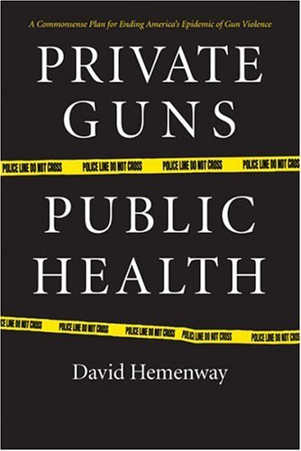
Private Guns
Public Health
David Hemenway
Harvard Injury Control Research Center
University of Michigan Press, 2006
Notes:
Private Guns
Public Health
David Hemenway
Harvard Injury Control Research Center
University of Michigan Press, 2006
Hemenway, D. 2006. Private Guns, Public Health. Ann Arbor, Mich.: University of Michigan Press.

